Slide 1
Building Competitive Advantages
for MCCANS
- A Pragmatic View
MCCANS
UAE CHAPTER
Celebrating the Path of Wisdom

Slide 2
Aim
To develop global supremacy for past pupils of Muslim Central College Akkraipattu National School (MCCANS) by
Integrating capabilities and advantages.
“Celebrating the Path of Wisdom”
Notes:
Links:
https://www.pexels.com/photo/photo-of-people-leaning-on-wooden-table-3183183/

Slide 3
The Problem
Outside world is changing rapidly; the majority of our students are not being shaped to succeed
Resource management is not materialistic
Building a social-school order
There is no stronger civil society who act with a common interest
The most important resource school produces is Human Resource
Schools’ society has a bigger role to prepare students to the later part of 21st century.
Unavailability of a Teachers Award System

Slide 4
Five Great Driving Forces About The World
Globalization of Industries
Digital Transformation and Technological Advancement
Virtual Education
Knowledge Workers
Covid 19 is a global pandemic its not clearly an epidemic
What is the significance?
“Celebrating the Path of Wisdom”

Slide 5
Challenges to the PPA
Missing out on developing meaningful ventures
Unavailability of ties to develop and maintain business contact to create job opportunities
There is no stronger civil society who act upon mother PPA interest
Building a functioning and flexible social-school order
Unavailability of an alliance with the teaching staff to maintain high educational standard
Maintain the ethical and moral standards of its alma-mater
“Celebrating the Path of Wisdom”
Notes:
Links:
https://www.pexels.com/photo/photo-of-person-pointing-on-laptop-3183171/
https://www.pexels.com/photo/macbook-pro-beside-papers-669619/

Slide 6
PPA Has a Major Role to Play
Run projects to promote independent learning
Build competitive advantages using HR
Connect the past-students via WWW
Regulating education transformation
Build a platform to contribute new/entrepreneurial ideas
Relevant library – Knowledge Development
“Celebrating the Path of Wisdom”

Slide 7
Proposed Road Map
Assess Capabilities of Chapters
Revamp
Collaborative Global Model Produce Results
Identify Unique
Advantages
Develop and Establish a Frame work
i.e Diffusion of power and stake
Develop Advantages
Mother PPA’s
Collaborative Approach
“Celebrating the Path of Wisdom”
Notes:
Links:
https://www.pexels.com/photo/photo-of-people-leaning-on-wooden-table-3183183/

Slide 8
Bibliography
McDonald, B. and McVeigh, J. (2006). Celebrating Friendship: Memories of Moneyvriece Primary School by the past Pupils. Clogher Record, 19(1), p.133.
Harvard Business Review. (2005). How Business Schools Lost Their Way. [online] Available at: https://hbr.org/2005/05/how-business-schools-lost-their-way.
London: Past and Present; its History, Associations, and Traditions. (1891). Notes and Queries, s7-XI(270), pp.179–179.
Veluchamy, R., Priyam, P. and Krishnan, A.R. (2016). Effectiveness of using WhatsApp to Manage Talents in Creating Student Superstars “Of the pupils, by the pupils, for the pupils.” Indian Journal of Science and Technology, 9(36).
Harvard Business Review. (2020). Learning from the Future. [online] Available at: https://hbr.org/2020/07/learning-from-the-future.
Notes:
Links:
https://www.pexels.com/photo/photo-of-people-leaning-on-wooden-table-3183183/

Slide 9
Bibliography
Ayeni, A.J. (2020). Principals’ instructional time management and students’ academic performance in secondary schools in Ondo North senatorial district of Ondo State, Nigeria. Journal of Education and Learning (EduLearn), 14(1), p.123.
Wikipedia,Free Encyclopedia (2008). Alumni. Extracted on the 20/10/2010“http://en.wikipedia.org/wiki/aluminiassociation” Wilkpadia, Free Encyclopedia (2010).
Tarsco Alumni Association (TAAS) Mission, Vision and Value Statement. Extracted on the20/10/2010“http://en.wikipedia.org/wiki/aluminiassociation”
Sports Participation and Physical Personality Variable of Students in Secondary Schools in Central Senatorial District of Cross River State, Nigeria. (2017). American Research Journal of Humanities and Social Sciences.
Copeland, I. (2001). Pragmatism: past examples concerning pupils with learning difficulties. History of Education, 30(1), pp.1–12.
Clem, O.M. and Hovey, C.W. (1933). Comparative Achievement of Village-School Pupils and Rural-School Pupils. The Elementary School Journal, 34(4), pp.269–272.
“Celebrating the Path of Wisdom”
Notes:
Links:
https://www.pexels.com/photo/photo-of-people-leaning-on-wooden-table-3183183/

Slide 10
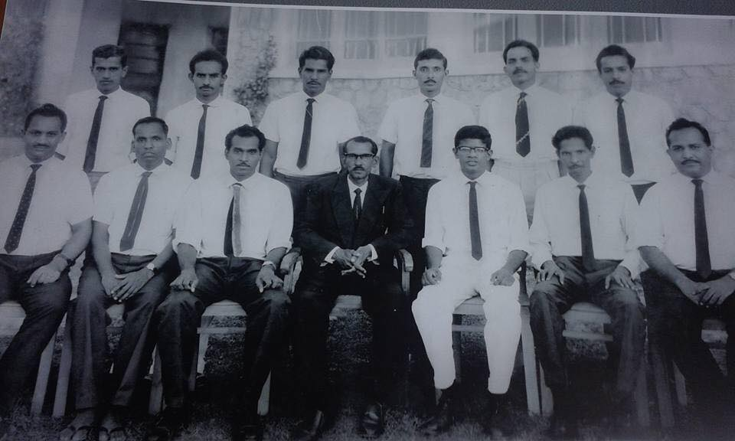
Ask not what your school can do for you
but what you can do for your school!
Dr Ashmel Hashim
MCCANS
UAE CHAPTER
Notes:
Links:
https://www.pexels.com/photo/macbook-pro-beside-black-ceramic-mug-on-black-table-3740704/

