Slide 1
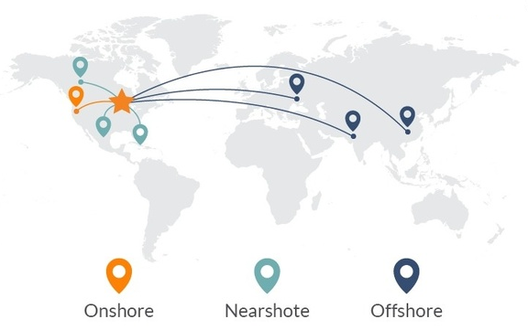



The Impact of Perceived Organisational Support on Employees’ Work Outcomes in Sri Lanka and The United Arab Emirates ; a Comparative Study in Information Technology Offshoring Industry.
- We invite comments. Please cite the authors in any publications relating to this paper.
Ashmel Hashim and Prof. Robin Matthews

Slide 2

Aim
The aim of the research is to undertake a comparative study by applying the concept of POS to Information Technology Offshoring (ITO) in Sri Lanka and UAE, using Structural Equation Modelling (SEM) based on Confirmatory Factor Analysis (CFA).

Slide 3

Perceived Organisational Support (POS) - Literature
POS is defined as the employees develop global beliefs concerning the extent to which the organisation values their contributions and cares about their well-being”
( Rhoades and Eisenberger, 2002, P, 698).
The theory suggests that this concept acts as a mediator between the way employees perceive their organization and the extent to which their work actions are aligned with its objectives.
POS predicts that to the extent they perceive their Organization’s support, employees reciprocate by acting in its interests.
POS is one of the widely studied theoretical constructs in organizational research (Rhoades and Eisenberger, 2002) with more than 350 scientific studies as a valid predictor of distinct organizational variables and excess of 600,000 empirical references on the internet (Emerson, 2013).

Slide 4
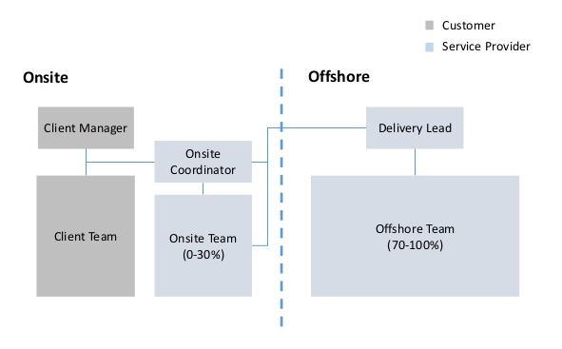
Distribution of Information Technology Offshoring (ITO)
ITO is described as an act of outsourcing (subcontracting) IT business processes to a company’s subsidiary or third parties
ITO is part of a global economy and larger phenomenon of distributed business, while much is described and anticipated about globalized work in general
There is a scarcity about the body of knowledge about IT offshoring, companies in the wealthy industrialized nations are dazzled by offshore programmers’ low wages.
Cost savings are the dominant reason for offshoring

Slide 5
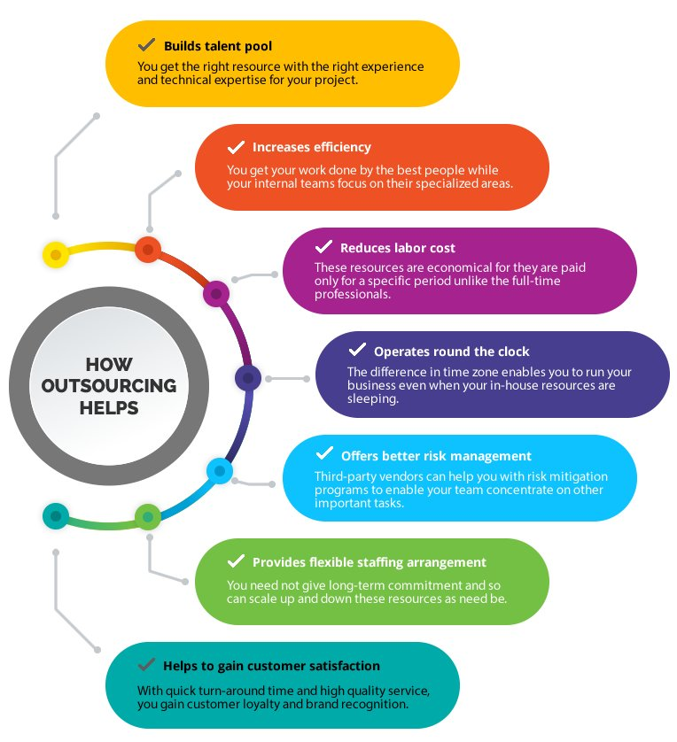

ITO is part of Global Economy
ITO is part of globalized economies, about U$ Trillion 4 worthy industry 2021
The ITO gained economic prominence primarily due to pursuit of low-cost structure and the ability to access a global resource pool
Even though the offshore could be typically described as anything other than the home country, as of today, it is understood that many ITO businesses are shifting their core and no-core tasks to the low-cost nation.

Slide 6

Research Problems Illustration
To influence employees’ work outcomes by optimising the POS in a manner that is sensitive to the socio-cultural setting
  Gap in the literature
  There is a paucity of research about POS and its impact in the context of developing countries.
  Context matters but context changes, changing demographic and socio-cultural factors.
  This is unfortunate because recent studies suggest that the effect of POS is contingent on demographic and socio-cultural parameters
  This research will benefit Sri Lanka’s and UAE’s IT-offshoring sectors by suggesting ways to improve work outcomes

Slide 7
Research Problem and Significance
Offshoring is distancing employees from their organisations, employees motivation is a key issue.
- Offshoring involves long hours of work and effort, developing workers centric is a priority.
Previous research shows that POS contributes positively to work outcomes and productivity.
POS is widely studied in organizational research; over 350 scientific studies and Google shows an excess of 600,000 empirical references.
How far is true in the context of emerging economies; under researched e.g. the UAE and SL.
ITO is a very significant component of the global economy.
Researcher’s long experience in the ITO sector both in SL and UAE.
Fascinating.

Slide 8
Research Approach and Methods
This research explores how the general theory of POS can be adapted to fit the context of Sri Lanka and the UAE, in a comparative study.
The conceptual model is based on
(a) CFA, with categories of observable variables and latent factors, derived from academic literature, and specified in the context of Sri Lanka and UAE which in turn is used to generate
(b) SEM to test empirically the impact of POS on employee work outcomes in ITO in Sri Lanka and UAE, independently and comparatively.
The overall approach resembles a mix of empiricism in the choice of SEM and CFA.
The observables derived from the research questionnaire-that closely followed the kind of questions asked by the other researchers.
his phenomenon indicates that this research approach had an element of empiricism and pragmatism, although this research adopts positivism as a research philosophy

Slide 9
Perceived Organisational Support
POS is defined as the employees develop global beliefs concerning the extent to which the organisation values their contributions and cares about their well-being”
Demographic and Socio-cultural Factors
Employees’ Work Outcomes
Organizational Support
Job Satisfaction
Organizational Fairness
Organizational Citizenship Behaviour
Supervisor Support
Perceived Organizational Support
In-role Performance
Pay level Satisfaction
Positive Mood
Turnover Intention

Slide 10
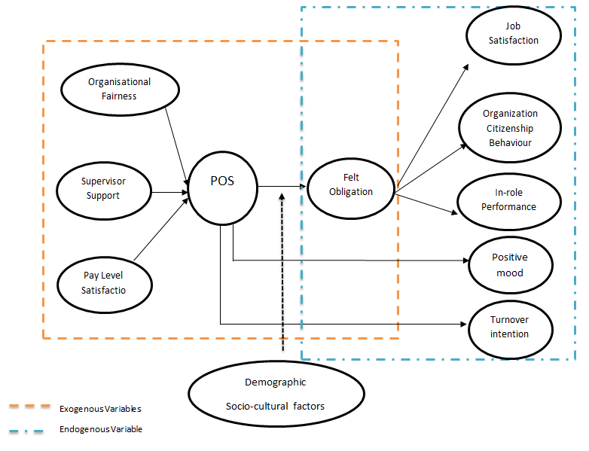
Derived Conceptual Model Path Diagram
The conceptual framework depicts the antecedents of POS, POS itself and outcomes of POS that have been coherently integrated.

Slide 11
The Vector Matric of SEM Model
X
(Xij)
(260 x 14)
ξ
Λ
Ij
(260 x 3)
F
(3 x14)
D
(260 x 14)
+
=
That has n sample observations (n=260), loaded onto14 indicator variables (x=14). This gives a sample total of 3640 data points (260 times 14).
Used to estimate the 3 exogenous variables (n=260 times F=3)
The estimated parameters represent λix (i=1, 2….260, x=1, 2…14) of underlying unobservable antecedents of POS (F = 3).
In regression, equations include a confirmatory term F= (ξ1, ξ2, ξ3) estimated parameters λix and an error term or unique part. When the indicator variables are represented in a diagonal matrix D = δij (i = j)

Slide 12
Data and Sample
410 online questionnaires were circulated proportionally using LinkedIn- Small-world Professional network .
Data were collected using self-administrated questionnaires.
A total of two hundred (260) employees’ responses (63% response rate), in distinguished hierarchies, in six (6) companies each in Sri Lanka and UAE.
141 responses from UAE and 119 from Sri Lanka were collected.
The research data was collected from December 2016 till April 2017.
The proposed research method assures a realistic sample size, reliable validity and inclined towards reverent findings.
The researcher used the past researchers’ questionnaire to the optimum level to ensure the validity, integrity and appropriateness of the questions.

Slide 13
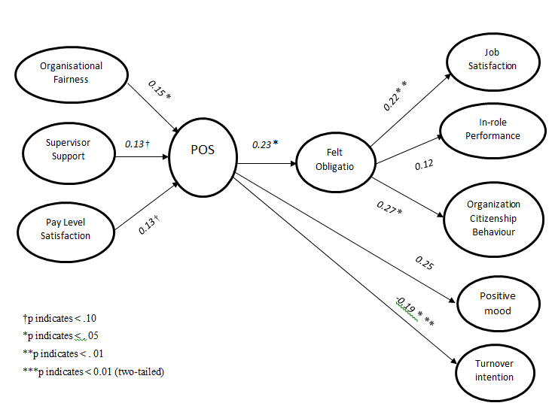
POS-ITO Structural Model
Most of the hypothesized empirical relationships were supported based on derived POS-ITO structural model.

Slide 14
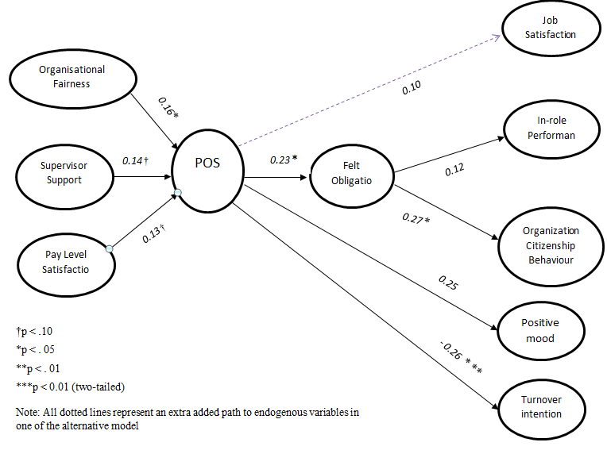
Alternative Models 1
Researcher tested and validated chain of alternative models that are closely associated or nested with the hypothesized model to figure out is there a better fit.

Slide 15
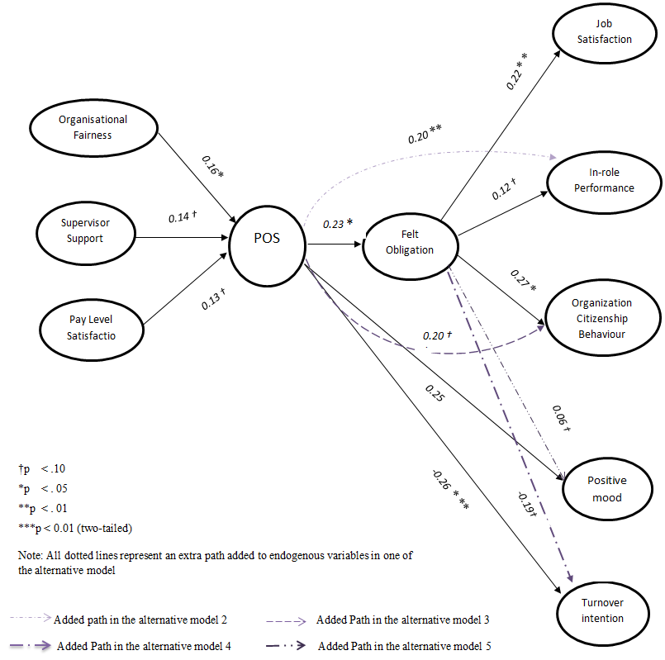
Alternative Models 2-5 CORE
Researcher tested and validated chain of alternative models that are closely associated or nested with the hypothesized model to figure out is there a better fit.

Slide 16
Contribution to the Knowledge – Theory
This comparative study tested the robustness of POS construct using the structural equation for empirically examining the impact of POS on employees work outcomes. specifically in two distinct socio-cultural settings.
The critical examination of the association between POS and various employees work outcomes lead to further insight into the influence of POS. On this basis, this research has made a significant contribution to the organizational support literature.
This research also validated the adaptability of POS to the ITO.
This research study is that it has contributed to the POS literature by diminishing the paucity of POS knowledge specifically in developing and emerging economies
Reveals POS-ITO model for generating organizational oriented employees’ work outcomes, which is relatively flexible and unique with the combination of selective ITO specific work outcomes.

Slide 17

Findings and Contributions 1
The primary merits of this research study are its empirical disposition and contribution to the paucity of knowledge of POS literature in emerging economies.
ITO workers were found to develop general beliefs to the extent to which their work organizations value work contributions.
Thus, employers need to pay attention in terms of how they design-develop relevant organizational support practices to generate organizational-oriented and beneficial employees work outcomes.
ITO workers’ work orientations and their supportive perceptions are contingent on both the individual and contextual characteristic of Sri Lanka and UAE. Hence, the applicability of global POS construct to a particular context becomes inconclusive unless the moderated impact is considered.
My research suggests that the influence of POS on employees work outcomes was moderated by the demographic and socio-cultural factors.

Slide 18

Findings and Contributions 2
Develop an ITO oriented POS scale for knowledge workers to better reflect their perceptions about their work organization.
The integrative POS-ITO model retains multidimensional paradigms underpinning organizational behavioural variables: practical, convertible, user-friendly, cost-effective and extendable for changing ITO context.
In UAE, ITO workers tent to value organisational fairness over pay level satisfaction, in contras, the reverse is true in SL.
It was evident that high-performing ITO economy (UAE) attracts migrant workers from lower-performing ITO economies.
High skills, relatively low pay are organizational conditions that apply to ITO workers generally in Sri Lanka.
In the future, competitive market theory suggest that wage levels will tend to equalise between the UAE and SL. And wages in emerging markets will tend to equalise with developed market wages. But markets may not be competitive in this way.

Slide 19
Contribution to the Knowledge – Practice
The present POS-ITO model is unique, innovative, practical and easily implementable as a Management Information System (MIS).
The current POS-ITO model can be used to diminish the undesirable paradoxes (inadequate work outcomes), under-deliveries (work-related deliveries) or weak practices associated with the organizational support models.

Slide 20
Contribution to the Knowledge – PhD
The present POS-ITO model is a new innovative approach for generating, retaining and regulating organizational oriented employees work outcome specific to ITO.
The current research study objectively identified the correct combination of antecedents of organizational support (specific to ITO) based on the previous researches.
It also has developed visibility on the robustness and extend-ability (moderation and mediation) process POS construct by embedding POS-ITO model, which retains multidimensional paradigms underpinning organizational behavioural variables: practical, convertible, user-friendly, cost-effective and extendable for changing ITO context

Slide 21
Findings and Contributions 3
It was also found felt obligation mediates the impact of POS on selective employees work outcomes (Job Satisfaction and Organisational Citizenship behaviour)
This provides scope of further research

Slide 22
Future Research Direction
Dissertation used the data of employees’ self-reported performance, thus, it could be viewed as a drawback in terms of producing quality data, because performance evaluation is generally done by employees managers or superiors.
Test the POS-ITO model using qualitative (interviews) data or using exploratory factor analysis. Examine the antecedents of POS, POS itself and outcomes of POS via longitudinal data (i.e time series). Reciprocity is a key feature of POS.
The POS scale used in this research was developed and primarily has been used with non-ITO employees. Thus, it is suggested that future researchers may consider developing ITO oriented POS scale for knowledge workers. i.e POS-ITO scale: my organization provides sufficient organizational resources for ITO workers to deliver IT deliveries, offers satisfactory compensation to contribute and help the organization to achieve its goals and objectives, offers incentives for on-time deliveries, permits the knowledge workers to determine how to perform their work, cares about the knowledge workers work-life balance, trusts and treats the ITO workers impartially.
Culture as a substantial variable was not included in the research scope. For example, it was found that employees are affectively inclined to perceive more supervisor support in a particular culture (Yoon and Thye, 2000).

Slide 23
References
Rhoades, L. & Eisenberger, R., (2002). Perceived Organizational Support: A Review Of The Literature. Journal Of Applied Psychology, 87, p.698-714.
Gyekye, S.A., 2009. Perceived Organizational Support : An African Perspective.,p.2651-2668.
Aselage, J. & Eisenberger, R., (2003). Perceived organizational support and psychological contracts : a theoretical integration. , 509(April), p.491-509.
Eisenberger, R. et al., (2002). Perceived Supervisor Support: Contributions To Perceived Organizational Support And Employee Retention. The Journal Of Applied Psychology, 87(3), p.565-573.
Byrne, Z.S. & Hochwarter, W.A., (2008). Perceived Organizational Support And Performance: Relationships Across Levels Of Organizational Cynicism. Journal Of Managerial Psychology, 23(1), p.54-72.
Elmuti, D., Grunewald, J. & Abebe, D., (2010). Consequences Of Outsourcing Strategies On Employee Quality Of Work Life , Attitudes , And Performance. Journal Of Business Strategies, 27(2), p.178-203.
Patrick, D. , (2003). Authoring A Phd : How To Plan, Draft, Write And Finish A Doctoral Thesis Or Dissertation, Palrave Macnillan.
Beaujean, A . , (2014). Latent Variable Modeling Using R: A Step By Step Guide, Focusing On The Lavaan Package.
Mitra, R.M., (2013). ADB Economics Working Paper Series The Information Technology And Business Process Outsourcing Industry : Diversity And Challenges In Asia. , (365).
Peterson, E., Bell, S. & Gott, J.,(2012). Competitive Benchmarking : Sri Lanka Knowledge Services. , p.1-24.

Slide 24
References
Avgerou, C. (2010). Discourses on ICT and development. Information Technologies & International Development, 6 (3), 1-18.
Bartol, K.M. (2007). When Perceived Organizational Support Matters Most: Mediating and Moderating Mechanisms among Knowledge Workers.
Beaujean, A. (2014). Latent variable modeling using R: A step-by-step guide. Routledge/Taylor & Francis Group.
Blaikie, N.W.H. and Priest, J. (2019). Designing social research : the logic of anticipation. Medford, Ma Polity Press.
Creswell, J.W. and J David, C. (2018). Research design : qualitative, quantitative & mixed methods approaches. Los Angeles: Sage.
Khan, S. U., Niazi, M., and Ahmad, R. (2011). Factors influencing clients in the selection of offshore software outsourcing vendors: An exploratory study using a systematic literature review. Journal of Systems and Software, 84(4), 686-699. https://doi.org/10.1016/J.JSS.2010.12.010
Kim, K. (2018). The Impact of Employees’ Perceived Supervisor Support on their Organizational Citizenship Behaviours : Moderated Mediation by Perceived Organizational Support and Positive Reciprocity. Korean Academy Of Leadership, 9(2), pp.67–94.
Kim, K.Y., Eisenberger, R. and Baik, K. (2016). Perceived organizational support and affective organizational commitment: Moderating influence of perceived organizational competence. Journal of Organizational Behavior, 37(4), pp.558–583.

Slide 25

Questions

Slide 26
Appendices

Slide 27
Literature

Slide 28
Information Technology Offshoring
ITO is described as an act of outsourcing (subcontracting) IT business processes to a company’s subsidiary or third parties with the responsibility of running a business process that would be conducted otherwise internally. I.e, IBM UK outsources software development works to their subsidiary or any of their business partners either in Sri Lanka or UAE.
ITO is part of a global economy and larger phenomenon of distributed business. Offshoring-information technology work is viewed as a breakthrough in the history of global economics
Is understood that many ITO businesses are shifting their core and no-core tasks to the low-cost nations.
Global spending in is expected to reach about USD 3 trillion by 2020.
  - Sri Lanka ITO is poised to achieve USD 5 billion in Export Revenue
  - UAE’s IT market is to reach Dirham (AED) 22 billion by 2020

Slide 29
Context – Literature
Though the primary antecedents of POS remain similar across, how those antecedents contribute to the development of POS could be different in two distinguished contexts (Liu, 2004).
The manner in which POS mediates the moderated impact on employees’ work outcomes needs investigation by integrating workers’ demographic and socio-cultural variables, pertaining to a particular context.
It also should be noted that quality of the employer-employee relationship is not gifted to workers, but gradually built under right organizational circumstances, which cannot be treated lightly. Therefore, the development of POS does not happen in isolation or vacuum, instead, the workers’ supportive perceptions are derived from the demographic and socio-cultural settings in which employees accomplish their daily work.

Slide 30
Measurement Models 1 and 2
CONCEPTUAL MODEL

Slide 31
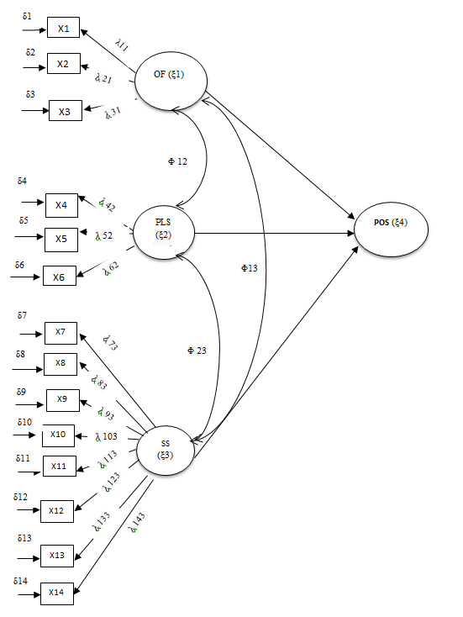
Measurement Models 1
* Notes for measurement model-I
x (chi) = Indicator variable or manifest variables
δ (delta) = Error term of indicator variable
λ (lambda) = Path core efficiencies of indicator variable
Φ (phi) = Covariance among exogenous variables
ξ (xi) = Exogenous Latent variables

Slide 32
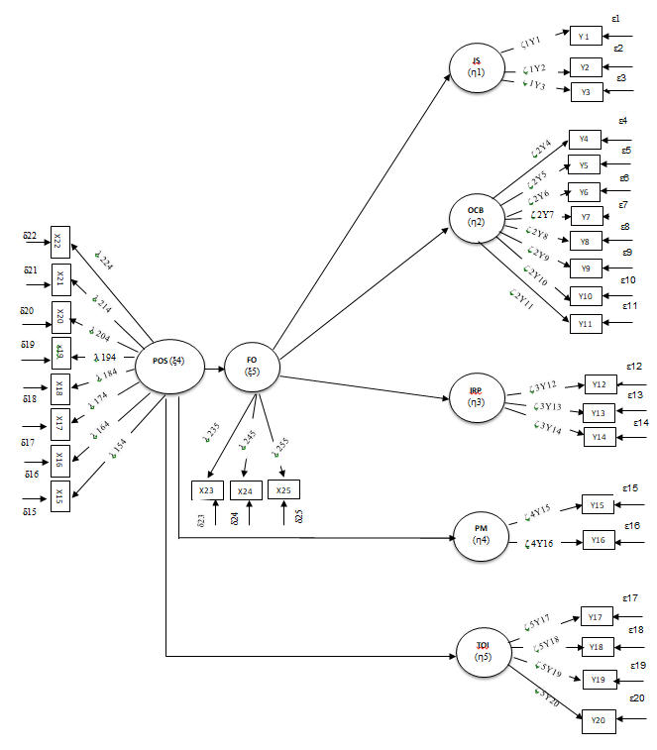
Measurement Models 2
**Notes for the measurement model-II
x (chi)/Y (upsilon) = Indicator variable or manifest variable
δ (delta)/ε (epsilon) = Error term of indicator variable
ζ (zeta) = Path core efficiencies of indicator variable
ξ (xi) = Exogenous Latent variables
η (eta) = Endogenous Latent variables

Slide 33
DETAILS
METHODOLOGY
SAMPLE
RESULTS

Slide 34
Key Research Outcomes
Key Elements | Outcomes of the Proposed Research
Nature of the Reality | Objectively develop and test a ‘POS-ITO’ model that optimises the knowledge workers work outcomes that are sensitive to particular contexts of Sri Lanka and UAE.
Hypothesis Testing | Hypotheses are purposeful and objectively formed prior to the study, focusing on moderating and the mediating mechanisms of POS.
Research Design Approach | Cross-sectional, objective and comparative study. Well planned and focuses on Perspective.
The Role of Value Approach | Make every attempt to be a transparent, value-free or natural enquiry or neutral.
Context | Independent of the context but purposeful (Sri Lanka and UAE).
Epistemological Stance | Etiological- the researcher is interested in why things happen.
Researchers’ Role | Emphasis on understanding the differences.
Study Orientation | Particularistic; studies the elements of POS, the impact of POS, moderation and the mediation mechanisms via measurable.
Research Focus | Variables and the integrated approach.
Research Basis | Reliability is based on the facts derived via the data.
Sampling | Representative.
Replication | Standard procedure and the replications are assumed.
Data Collections | In the form of responses, quantifiable via numbers or expression.
Data Analysis Approach | Statistical approach within the SEM framework
Interpretation Approach | Performs using statistics or tabular format or chart. The emphasis is on how and why they relate to the proposed hypotheses prior to the study. The Constructive development of the conclusions based upon the data; clarity is based upon interpreting numerical data.
Reporting | Extensively numerical and integrated. However, the description is given to express logical outcomes.

Slide 35
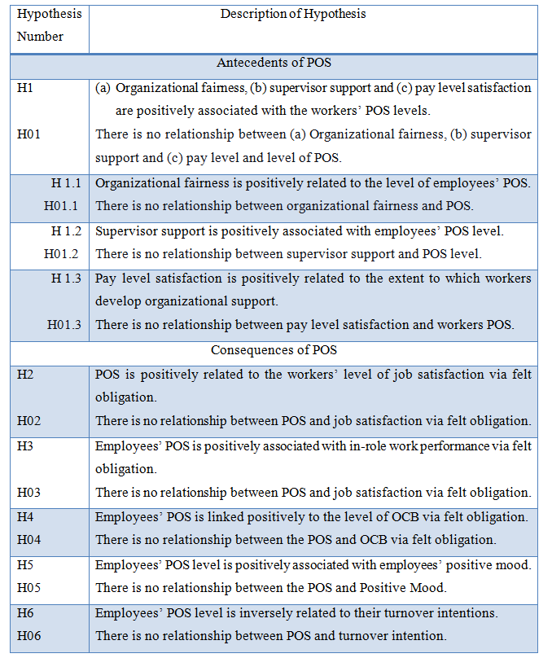
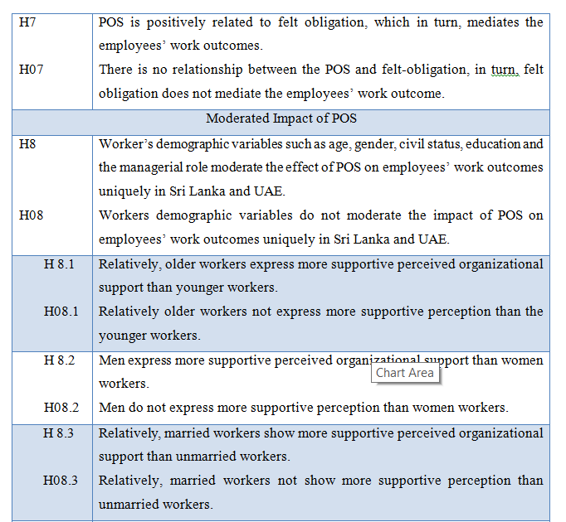
Summary of Hypotheses

Slide 36
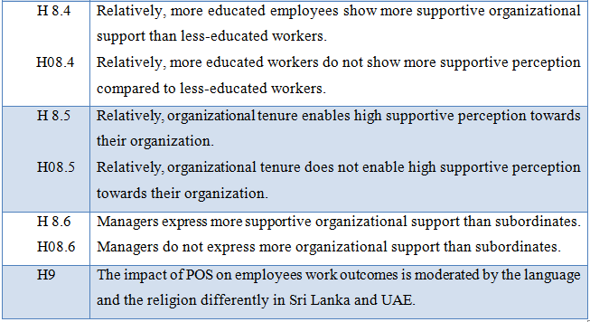
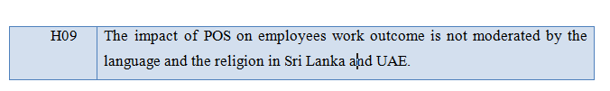
Summary of Hypotheses

Slide 37
Analytical Procedure
First, the researcher defined the individual constructs by determining what variables were to be used as measured variables .
Second, the researcher developed and specified the measurement model by using CFA. This was possible by connecting both exogenous and endogenous variables through SEM using ‘AMOS
Third, the antecedents of POS are viewed as the exogenous variables that, excluding the error terms, are loaded upon the observable variables.
The overall fit of the model was validated using the fit indices.
The goodness of the fit indices indicates whether the model is a good predictor of anticipated results such as employees’ work outcomes.
If the measurement model was valid, then the researcher proceeded with the structural model.
In this stage, the key focus was to convert the measurement model to a structural model to assess the structural model validity. Assessing the structural model validity was the basis for drawing empirical conclusions

Slide 38
Descriptive statistics of questionnaires circulated, responses received and its composition
Items | Quantity | Description of the workers | Total No of Companies Targeted | Comments
Total Number of Questionnaire Circulated. | 410 | About 63%. | 12 Small, Medium and Large size ITO companies. | Relatively, gaining 63% of questionnaire responses rate was possible by chasing the questionnaire responses via the LinkedIn small-world professional network on a regular basis.
Total Number of Returned Questionnaire Responses. | 260 | Participants were 260 Information Technology Offshoring workers who carry out IT works in cost-sensitive locations. |  | The ITO workers were involved in software development related work.
Total Number of Responses received in the UAE. | 141 | About 54%. | 6 ITO Companies | The ITO workers were involved in software development related work.
Total Number of Responses received in Sri Lanka. | 119 | About 46% | 6 ITO Companies | The ITO workers were involved in software development related work.

Slide 39
DATA ANALYSIS AND RESULTS

Slide 40
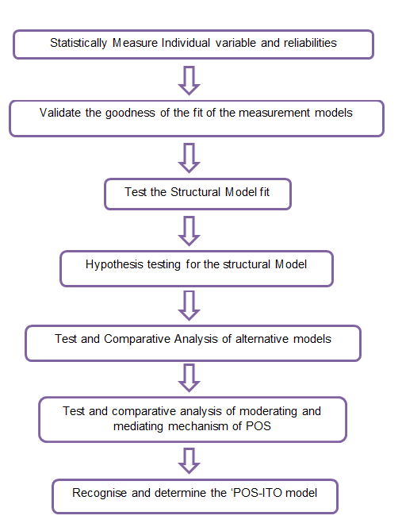
Approach To Analysis
The graphical representation demonstrates the logical approach (steps) that was taken by the researcher to steer the data analysis.

Slide 41
Analysis: Measurement Model I
Classification of Fit indices | Absolute Fit |  |  |  |  | Incremental Fit |  |  |  | Parsimonious fit
Ideal Model | x2 | DF | GFI | RMSEA | PV | AGFI | CFI | NFI | TLI | x2/df
Relative Benchmark |  |  | > .90 | > 0.08 | > 0.05 | > .90 | > .90 | > .90 | > .90 | <5.0
Measurement Model –I ** | 107.42 | 181 | 0.95 | 0.22 | 0.18 | 0.92 | 0.98 | 0.85 | 0.97 | 1.13
Measurement Model-1 | 304.6 | 201 | 0.90 | 0.04 | 0.00 | 0.88 | 0.90 | 0.75 | 0.88 | 1.51
** The indicator variables greater than 0.4 in the standardised residual covariance matrix were removed.

Slide 42
Analysis: Measurement Model II
Classification of Fit indices | Absolute Fit |  |  |  |  | Incremental Fit |  |  |  | Parsimonious fit
Ideal Model | x2 | DF | GFI | RMSEA | PV | AGFI | CFI | NFI | TLI | x2/df
 |  |  | > .90 | > 0.08 | > 0.05 | > .90 | > .90 | > .90 | > .90 | <5.0
Measurement Model –II ** | 246.40 | 201 | 0.902 | .030 | 0.16 | .884 | .940 | 0.749 | 0.945 | 1.226
Measurement Model-II | 612.40 | 425 | .87 | .041 | 0.00 | .84 | .86 | .67 | .85 | 1.22
** The indicator variables greater than 0.4 in the standardised residual covariance matrix were removed.

Slide 43
Alternative Model Testing for the Structural Model
Models | x2 | DF | AIC | RMSEA | CFI | GFI | TLI | X2/DF
Independence Model | 3278.48 | 990 | 3368.48 | - | - | - | - | -
Structural Model ** (POS-ITO) | 550.87 | 480.00 | 712.87 | 0.02 | 0.95 | 9.00 | 0.94 | 1.14
Structural Model | 1245.67 | 929 | 1457.67 | 0.03 | 0.83 | 0.86 | 0.85 | 1.34
Alternative Model 1 | 554.78 | 480.00 | 716.78 | 0.03 | 0.94 | 0.90 | 0.94 | 1.15
Alternative Model 2 | 549.45 | 479.00 | 713.45 | 0.02 | 0.94 | .90 | 9.40 | 1.14
Alternative Model 3 | 548.33 | 480.00 | 710.33 | 0.23 | 9.47 | 0.90 | 9.41 | 1.14
Alternative Model 4 | 550.17 | 480.00 | 712.17 | 0.24 | 0.94 | 0.90 | 0.94 | 1.14
Alternative Model 5 | 550.05 | 479.00 | 714.05 | 0.24 | 0.94 | 0.90 | 0.93 | 1.14

Slide 44
Comparative View of Hypotheses Test results
Global Level Vs Local levels
Global ITO level
Antecedents of POS | Individual (b =value) | Individual ( p =value) | Significance (***)
OF | 0.15 | 0.10 | Marginal
SS | 0.13 | 0.19 | Marginal
PLS | 0.13 | 0.19 | Marginal
Sri Lanka ITO level
OF | 0.18 | 0.16 | Marginal
SS | 0.19 | 0.16 | Marginal
PLS | 0.29 | 0.02 | Highly
UAE ITO level
OF | 0.16 | 0.25 | Marginal
SS | 0.04 | 0.75 | Not significance
PLS | -0.09 | 0.53 | Not significance

Slide 45
Comparative View – The Common Differences of Variables in Sri Lanka and UAE
 |  | Predictor Variable | Outcome variables
 |  | Felt Obligation | JS | IRP | OCB | PM | TOI
 | Variable | β | β | β | β | β | β
Global SL UAE | POS POS POS | 0.23 0.13 0.47 | 0.22 0.25 0.18 | 0.12 0.31 0.08 | 0.27 0.43 0.03 | 0.26 0.46 0.63 | - 0.19 -0.29 - 0.25

Slide 46
Moderation of Demographic and Socio-cultural Parameters E.g. Gender
 |  | Predictor Variable | Outcome variables
 |  | Felt Obligation | JS | IRP | OCB | PM | TOI
 | Variable | β | β | β | β | β | β
Step 1 Step 2 | POS Male Female | 0.23 0.04 0.50 | 0.22 0.17 0.33 | 0.12 0.16 0.17 | 0.27 0.33 0.06 | 0.26 0.24 0.33 | - 0.19 - 0.09 - 0.12

Slide 47
Mediation of Felt Obligation on JS, IRP and OCB
Independent to Dependent Variable | Independent Variable to Mediator (POS) | Mediator Variable (FO) | Dependent Variables (JS, IRP & OCB) | Probability | Outcome
POS→JS | POS→ FO | FO→ JS | Job Satisfaction
β = 0.05 | β = 0.23 | β = 0.20 |  | P= 0.013 | Partial mediation
POS→IRP | POS→ FO | FO→ IRP | In Role Performance
β = 0.39 | β = 0.30 | β = 0.11 |  | P= 0.017 | Partial Mediation
POS→OCB | POS→ FO | FO→ OCB | Organizational Citizenship behaviour
β = 0.12 | β = 0.22 | β = 0.24 |  | P= 0.014 | Partial Mediation

Slide 48
Results of Hypotheses 1

Slide 49
Results of Hypotheses 2

Slide 50
CONCLUSIONS AND RECOMONDATIONS

Slide 51
Conclusions And Recommendations 1
The primary merits of this research study are its empirical disposition and contribution to the paucity of knowledge of POS literature in emerging economies.
ITO workers were found to develop general beliefs to the extent to which their work organizations value work contributions.
Thus, employers need to pay attention in terms of how they design-develop relevant organizational support practices to generate organizational oriented and beneficial employees work outcomes.
Consider developing an ITO oriented POS scale for knowledge workers to better reflect their perceptions about their work organization, the emphasis placed on the nature of organizational support practices and individual work responsibilities.
ITO workers’ work orientations and their supportive perceptions are contingent on both the individual and contextual characteristic of Sri Lanka and UAE.
Hence, the applicability of global POS construct to a particular context becomes inconclusive unless the moderated impact is considered.

Slide 52
Conclusions And Recommendations 2
The differences in expressing supportive perception between ITO and non-ITO could be characterized to lucrative organizational conditions and agreements of service that ITO employees amuse.
The integrative POS-ITO model retains multidimensional paradigms underpinning organizational behavioural variables: practical, convertible, user-friendly, cost-effective and extendable for changing ITO context.
It was evident that high-performing ITO economy (UAE) attracts migrant workers from lower-performing ITO economies.
High skills, relatively low pay are organizational conditions that apply to ITO workers generally in Sri Lanka. However, mostly, high skilled and high paid migrant ITO workers are hired by the employing companies in the UAE.

Slide 53
Future Research Direction

Slide 54
Future Research Direction 2
To provide dependable returns (ROI via employees’ work outcomes worth the investment) to the organization, it is critical to understand how much it costs to develop a POS-based management information system (POS-ITO) in order to determine the adequate organizational support level.
What would be a rational statistical technique that could be inherited (not part of the present scope) with the present POS-ITO model and how do the offshoring organizations can regulate and achieve the fullest impact of perceived organizational support needs to be investigated.
researchers should examine factors to maximise the main causes of organizational support specifically in the emerging economies but not limited to organizational fairness, supervisor support and pay level satisfaction

Slide 55
Future Research Direction 3
The unique differences in culture also may be included as a moderator variable in such researches. Because, yet, culture is another variable which continues to remain as a ‘black box’ for generating tangible and sizeable performance
The mediating variable is limited via POS-Felt obligation path. Extensive future research is necessary to recognize the impact of POS and new feasible moderators and mediators along the process.
It was found in this research that the application of organizational support on organizational practice directly or directly impacted the daily life of knowledge workers in Sri Lank and UAE. Yet, it is arguably important to figure out what percentage of the organization produces adequate organizational support.
Multi-level variance analysis can be performed selectively to examine how the POS based ITO practices may impact employees’ perception of their work organization support, which in turn, influence their work performance, ultimately make a potential difference in the overall organizational performance

